Slide 1

The information capacity of visual experience at a brief glance
Qianchen Liang
Supervisors: Naotsugu Tsuchiya, Regan Gallagher, and Liad Mudrik

Slide 2
Information as contents of perception
Visual information is what we see: objects, visual details and features that enter our perception
The more we see, the more information we get!
Alvarez & Cavanagh, 2004; Cohen et al., 2016
Notes:
The information we get from our visual experience has traditionally been defined as what we see, namely, the objects, along with the details and features of them, that enter our perception.
For example, I see a lot of people here, the people I see is some of the information I get from my experience right now
And so the more objects and details that I happen to be seeing, the more information I get.

Slide 3
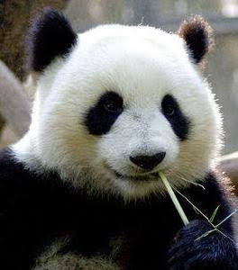
Information as contents of perception?
Notes:
If we accept this definition of information, consider this photo.
The one and only information we get, then, is panda, given our perception of it.
Does this mean everyone get the exact same amount of information from the perception of this panda?
Instead of looking at the signals coming from the environment, we should also look at how such perception is internally represented in us.

Slide 4
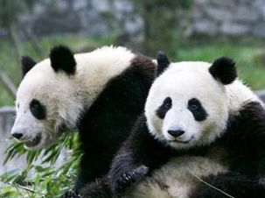
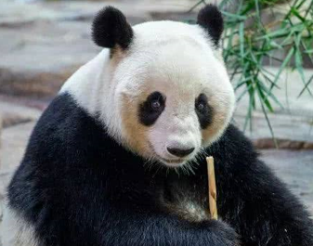
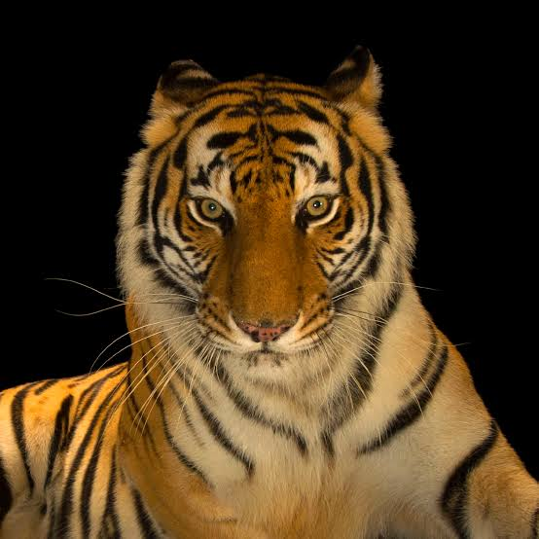
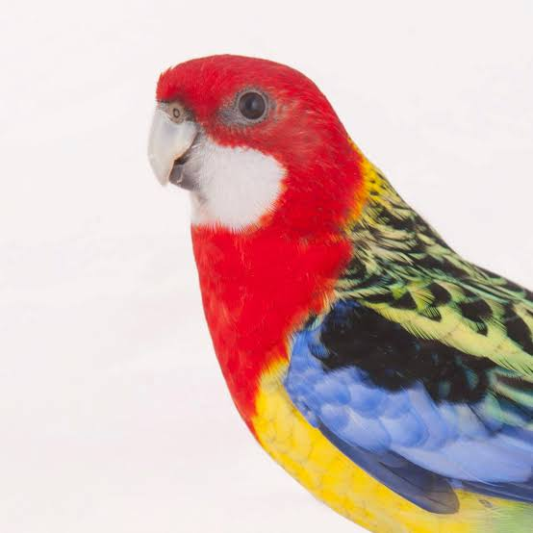

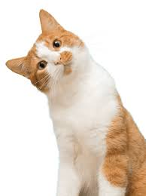
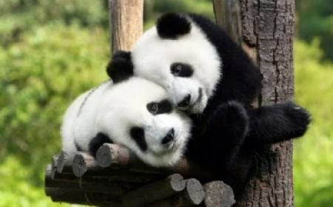
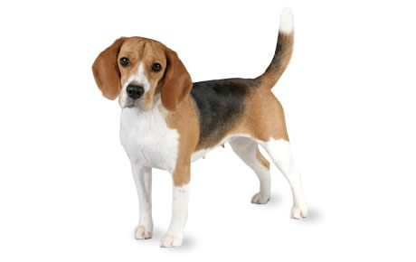
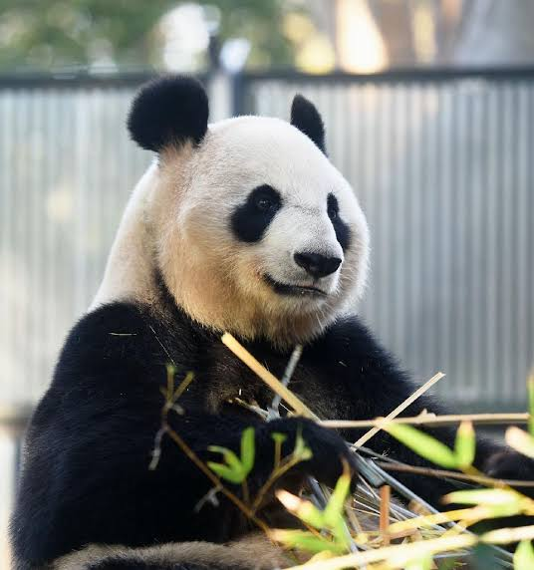
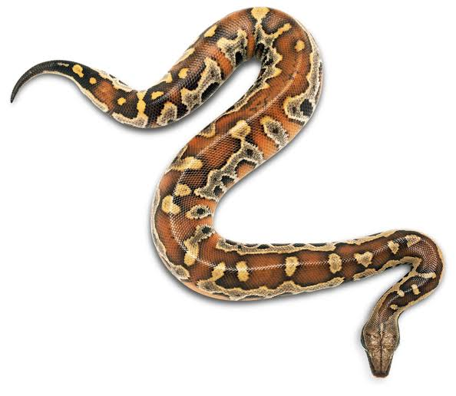
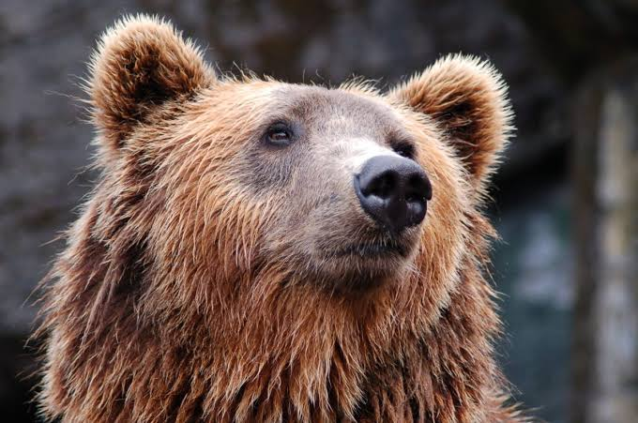
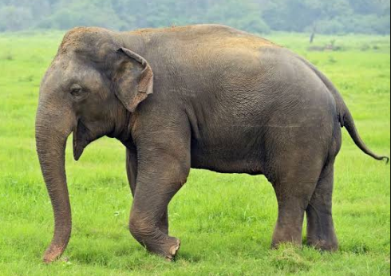
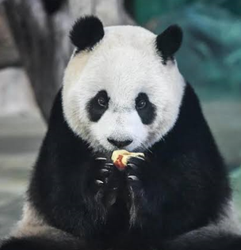
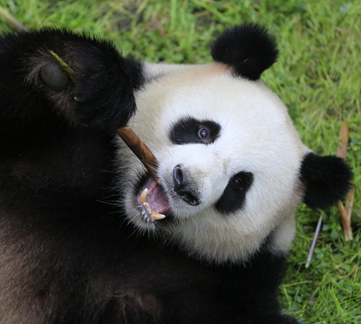
Information as differentiation
…
…
Notes:
Rather than focusing on the panda itself, lets consider what are the things that we can distinguish it from.
For us, with some common knowledge about animals, as soon as we have a perception of this panda, we automatically know it is not all these animals; that is, this panda, for us, distinguishsed from other animals
However, for a huge fan of panda, in addition to all the animals here, she can also distinguish this panda from all these pandas here.
So that the same perception of panda can be represented differently in each one of us

Slide 5
Information and differentiation
Information theory (Shannon, 1948): The amount of information that an event carries is characterized by the number of alternatives it can exclude
Notes:
And differentiation game is not just a battle between you and a fan of panda, but is in fact, the theoretical basis to information itself
According to information theory, the amount of information that an event has is characterized by the number of alternatives it can exclude

Slide 6
Information and differentiation
Information of a visual experience
=
Contents present
Contents absent
Notes:
If we translate this to our visual experience, it means that the informat…
Is not only what you see, which are the contents present in your experience, but also the things you don’t see, that you can discriminate from the things you see

Slide 7
Research question
How informative is a moment of visual experience, as characterized by observers’ ability to differentiate contents present and absent in a briefly-presented image?
Notes:
As we know from the animal differentiation game, differentiating present and absent contents seems so easy and quick, and we can do it almost at the first glance of whatever we see.
The research question for my experiemtn is,

Slide 8
Experiment task demo
Notes:
to address this question, we developed a paradigm. Instead of verbally explaining it, I prefer to show you a demo directly.
I will flash an image on the screen very briefly, and then flash a patch, and you can tell me whether the patch is a part of the image

Slide 9
Shout “Yes!” if you think the patch is part of the image
And shout “No!” if you think it is not

Slide 11


Slide 13


Slide 14
Do you think the presented patch belongs to the image?
Notes:
Similarly, a no response with confidence of 3 is produced by clicking on 3 on the left hand side, combined response value being minus 3

Slide 16


Slide 17
Do you think the presented patch belongs to the image?
Notes:
Similarly, a no response with confidence of 3 is produced by clicking on 3 on the left hand side, combined response value being minus 3

Slide 18
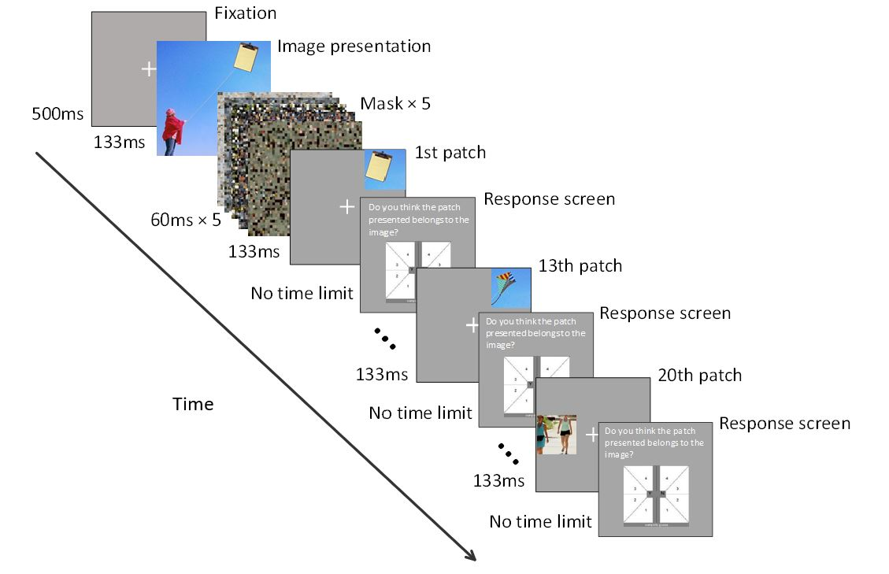
Decision
Decision
Decision
Notes:
So that was the short demo, and this is how the experiment would actually look like. We present the image briefly, then mask it, and then present a patch, also very briefly.
And then they are asked to judge whether a patch comes from the image, repeatedly

Slide 19
General methods
Each trial, we present one image, and ask 20 questions
Accuracy in endorsing patches from the image, and rejecting patches not from the image 🡪 informativeness of image perception
15 participants, each completed 80 trials of computer-based patch recognition task
Notes:
And their accuracy in judging what actually comes from the image as present, and what are not part of the image as absent tells us how well they differentiate between contents present and absent in the image
Which stands for the informativeness of their brief visual experience of that image
We got 15 participants, each completed 80 trials of such task.

Slide 20
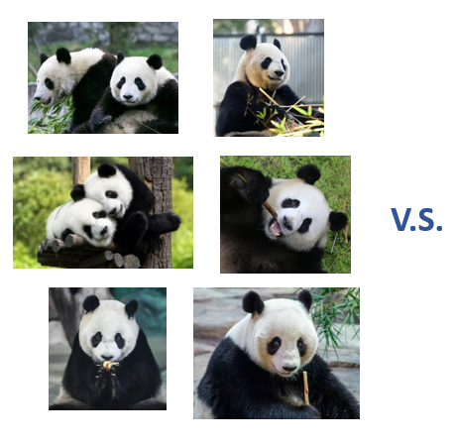
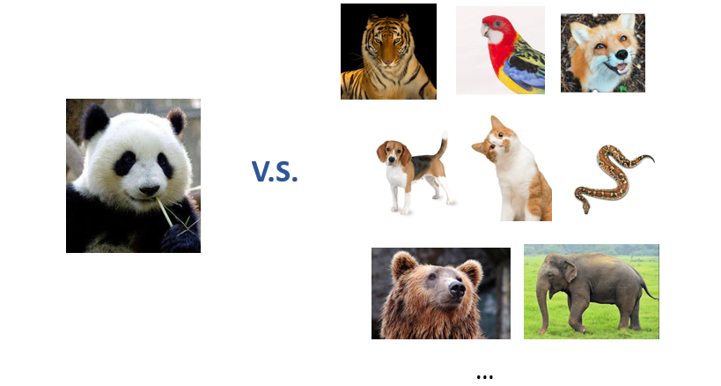
Levels of differentiation
Two types of patches absent in the image, to be compared with present patches
Examine general and fine-grained differentiation ability
Notes:
So far we know that this task consist of discriminating between patches from the image and patches not from the image.
But what are the absent patches exactly? How different are they from the present patches?
Here, we used two types of patches, one looks quite different from patches from the image, which is like how different those animals are from pandas.
The other type looks a lot more similar than the present patches, which is similar to panda-panda comparison
So that by comparing your responses to present patches with your responses to the two types of absent patches, we can examine your general (panda-animal differentiation) differentiation and differentiation between contents differing in fine-grained details
I will explain to you each level of the differentiation, and show you the results.

Slide 21
General differentiation

Slide 22


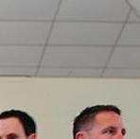





General differentiation
Patches cut from the image (i.e. contents present) v.s. patches cut from images from a different image set (i.e. contents absent)
Notes:
General differentiation, we compare participants’ responses to patches directly cut from the original image, so assume this is the image
And we cut them into 9 equal-size patches

Slide 23


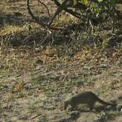


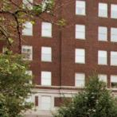

General differentiation
Patches cut from the image (i.e. contents present) v.s. patches cut from images from a different image set (i.e. contents absent)
V.S.
15 Patches from a different image set (Nishimoto, 2015)
Notes:
We take four of them, and we compare participants’ response to each of the four patches here,
with each of 15 patches randomly selected from images from a different natural image set
and how well did participants perform this differentiation?
It can be similar

Slide 24
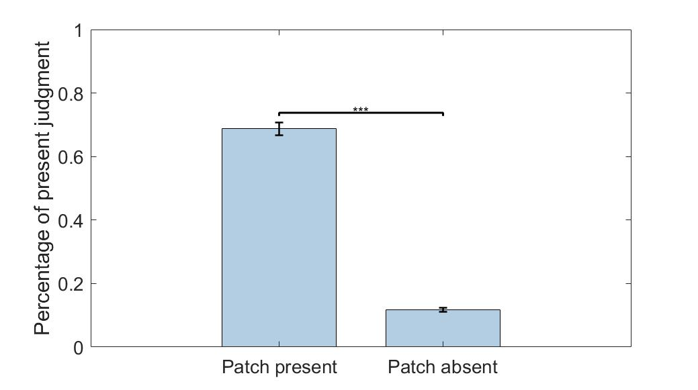
General differentiation: Results
p<.001
Notes:
The figure here shows mean percentage of “present” judgments given to patches coming from the image, and patches from different image set.
Error bars for within-subject standard error
As we can see, participants did quite well at differentiating between what they see and what they dont., as they are very accurate in judging what they see in the image as present, and rejecting what they did not see.

Slide 25
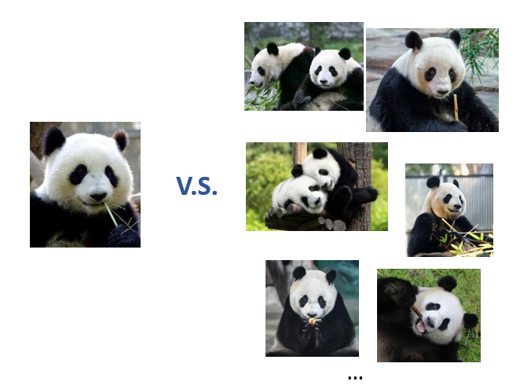
Fine-grained differentiation?

Slide 26

Fine-grained differentiation?
v.s.
Original object
Replaced object
Image adopted from Shir, Levy and Mudrik (in preparation)
Notes:
Recognizing the envelope among other patches looking like this can be easy
But what about a patch like this? Is your visual experience sensitive enough to endorse the envelope as the exact object from the photo, while reject the CD?

Slide 27
Fine-grained differentiation
Same object in the image v.s. a different object
V.S.
Notes:
So this is the fine-grained differentiation we wanted to look at. One of the 20 patches are modified from the original patch by replacing an object
So that the modified version of it looks very similar to the original, yet it is not part of the image.
How well did participants do such differentiation?

Slide 28
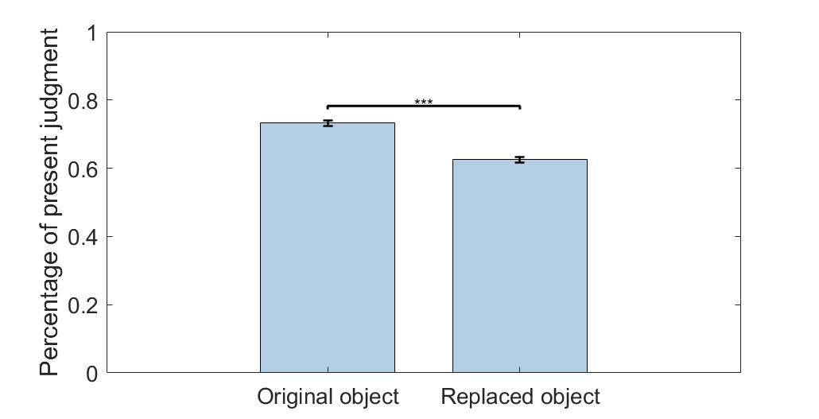
Fine-grained differentiation
P <.001
Notes:
They can still distinguish the fine-grained patches
And we can see they are not so good at doing this task, given the high proportion of present judgments given to patches showing a different object.

Slide 29
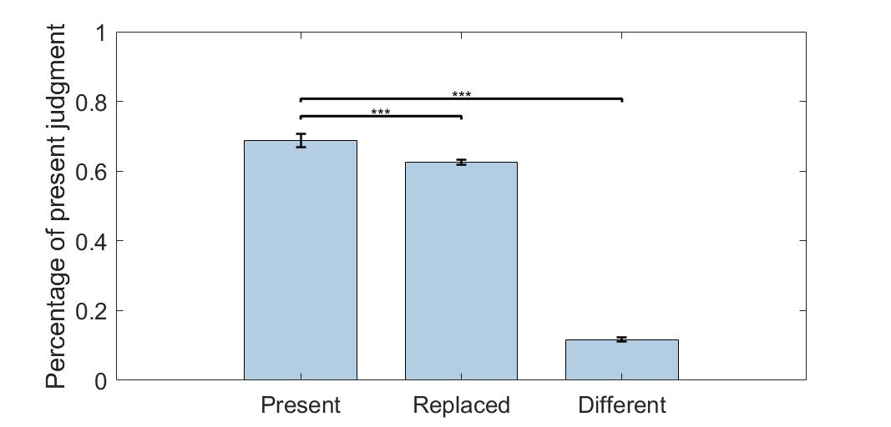
Notes:
And if we summarise our findings together here, we see that they are very good at general differentiation, but not so good at fine-grained differentiation

Slide 30
Discussion
Our visual experience: informative but with limit
Contents absent and perceptually different
Contents absent but similar
Contents present
Notes:
Given our results, we know that our visual experience at a glance is very informative, as we can easily distinguish between contents present, and a lot of contents absent
However, this differentiation ability has a limit; when the present and absent contents are perceptually very similar, then it is difficult to differentiate between the two
This is exactly the scenario where we are good at differentiating between the panda we see with other animals, but we are not as good in finding out that one panda we saw from different pandas.

Slide 31
Future directions
Upon a brief glance, people can easily reject 15 contents absent
How many absent contents can they possibly reject, 30, 50, 80, …300?
Upper bound of differentiation
Contents absent and perceptually different
Content present
Notes:
We know that upon a brief glance, people can easily reject many contents absent from their experience
We only ask participant to reject 15 absent patches, but how many patches can they possibly reject? 30, 50…?
Potentially, by asking participants to reject many many absent patches, we can expand this absent content space for our experience
and explore the upper bound of differentiation

Slide 32
Future directions
Contents absent but similar
What is the perceptual difference threshold for effective differentiation?
Contents absent and perceptually different
Contents present
?
Notes:
Also, we knowed that participants are not quite good at differentiating between present and absent contents, when they look similar
Manipulate the degree of perceptual difference between content present in the image, and contents absent in the image, and explore how different the contents absent needs to be, to be distinguished from present contents

Slide 33
Significance and innovation
Novel conceptualisation of visual experience:
The information of visual experience concerns both the what we perceived from the environment, and also how the perception is internally represented (differentiation)
Notes:
This study uses a very simple differentiation task, but it provides a novel perspective for understanding visual experience.
Compared to how visual information is traditionally defined, it takes into account both contents that enters our perception, and contents absent in our experience that we can distinguish from.

Slide 34


Acknowledgement
A/Prof Naotsugu Tsuchiya
Dr. Regan Gallagher
Dr. Liad Mudrik

Slide 35

Acknowledgement
And all members of the Tsuchiya Lab!

Slide 36
Thank you

Slide 37
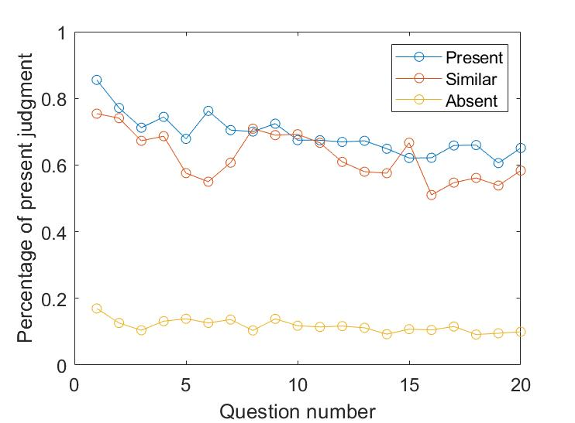
Supplementary slide

Slide 38

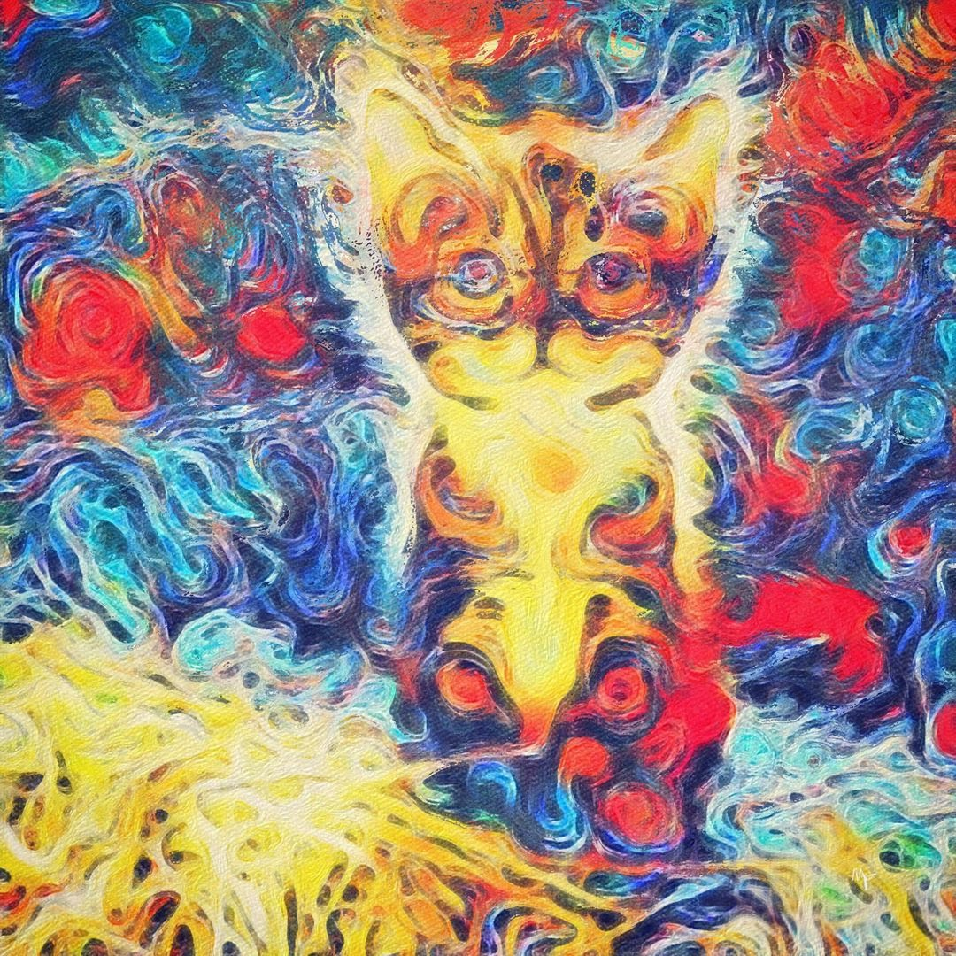
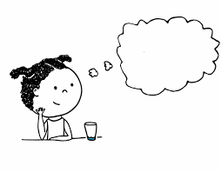

Supplementary slide
Distorted perception = impaired ability to rule out certain possibilities?
Visual hallucination
External stimuli
Internal imagery
Stephan-Otto et al., 2017
Notes:
For example, we can understand distorted perception in mental disorders
If a schizophrenia patient sees a cat that does not actually exist, which is a visual hallucination this does not mean seeing more things, and get more information from the environment,
Rather, according to recent studies, it comes from an impaired ability to differentiate between what is actually perceived in the environment, and their internal imagery of a cat
So its an impaired ability to rule out this specific kind of possibilities

Slide 39
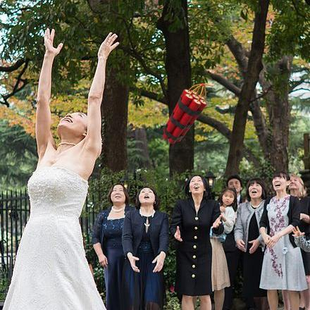



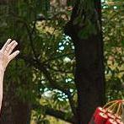
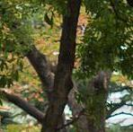

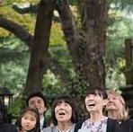

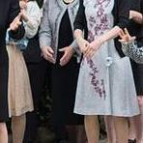
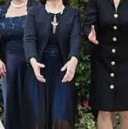
Methods: Images and patches
Incongruent trial × 40
Presented Image | Test probes (presented in randomised order) |  |  | Total number of test probes
Congruent | Congruent P1 & incongruent P1 | 4/5 P2 patches | 15 N patches | 20/21
1
2
3
4
5
6
7
8
9
Notes:
In each session, a participant will complete 40 incongruent trials and 30 congruent trial.
In an incongruent trial, an incongruent image like the wedding photo with a dynamite, will be presented. We will test participants on both the incongruent and congruent P patches.
the A will be selected in a way that A and P patches are not in contiguous locations in the image. the critical object is in location 5, then the A patches we choose will be 1, 3, 7, 9; similarly, if in another photo, the critical object is in one of 2,4,6,8, then we choose the A patches from 2,4,6,8
Each N patch an observer see will be different from other N patches he/she see in the whole session, as well as patches that other subjects see. Each of the N patches will only be presented once across our whole experiment testing.
I will explain to you later why we do this in a minute

Slide 40
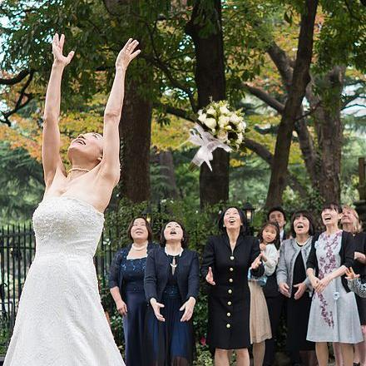
Methods: Images and patches
Congruent trial × 40
Presented Image | Test probes (presented in randomised order) |  |  | Total number of test probes
Congruent | Congruent P1 & incongruent P1 | 4/5 P2 patches | 15 N patches | 20/21
Notes:
The congruent trials follows the same structure as the incongruent trial, except that the image presented is a congruent one.

